Slide 1


Overview of the Year 5 Evaluation/Pilot Test
October 1, 2019 to September 30, 2020

Slide 2
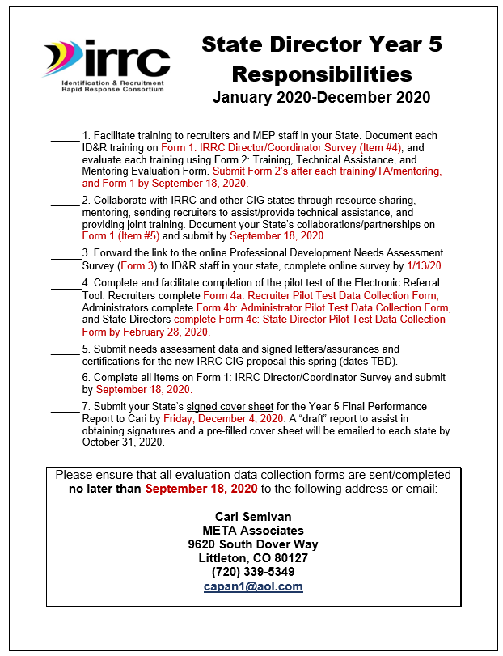

Year 5 State Director Checklist
The State Director Checklist lists everything required of State Directors until next fall, including due dates.

Slide 3

Year 5 To Do…
Provide training on ID&R in your states. Document training on Form 1 and evaluate training using Form 2.
Collaborate with IRRC and other CIG states through resource sharing, mentoring, sharing recruiters, and providing joint training. Document collaborations on Form 1.
Facilitate the pilot test of the Referral Tool (recruiters, administrators, State Directors). Complete by February 28, 2020.

Slide 4
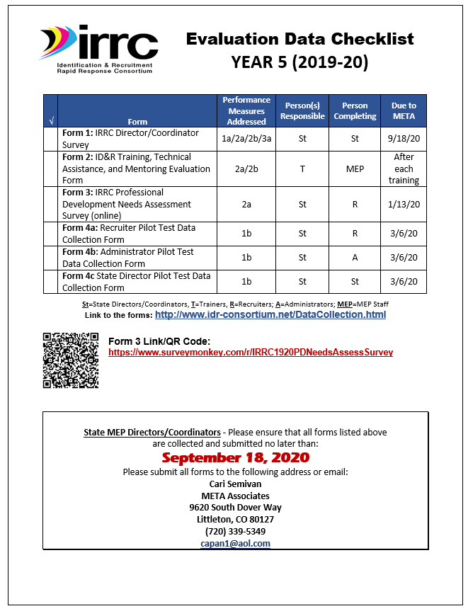
Year 5 Evaluation Data Checklist
The Year 5 Evaluation Data Checklist lists all IRRC data collection forms, performance measures addressed, persons responsible, persons completing the forms, and due to META

Slide 5
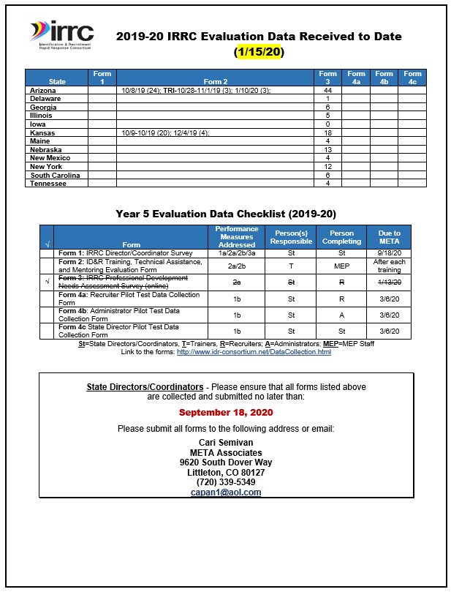
Year 5 Data Received To Date
Shows data received to date
Lists all data required for the Year 5 evaluation

Slide 6
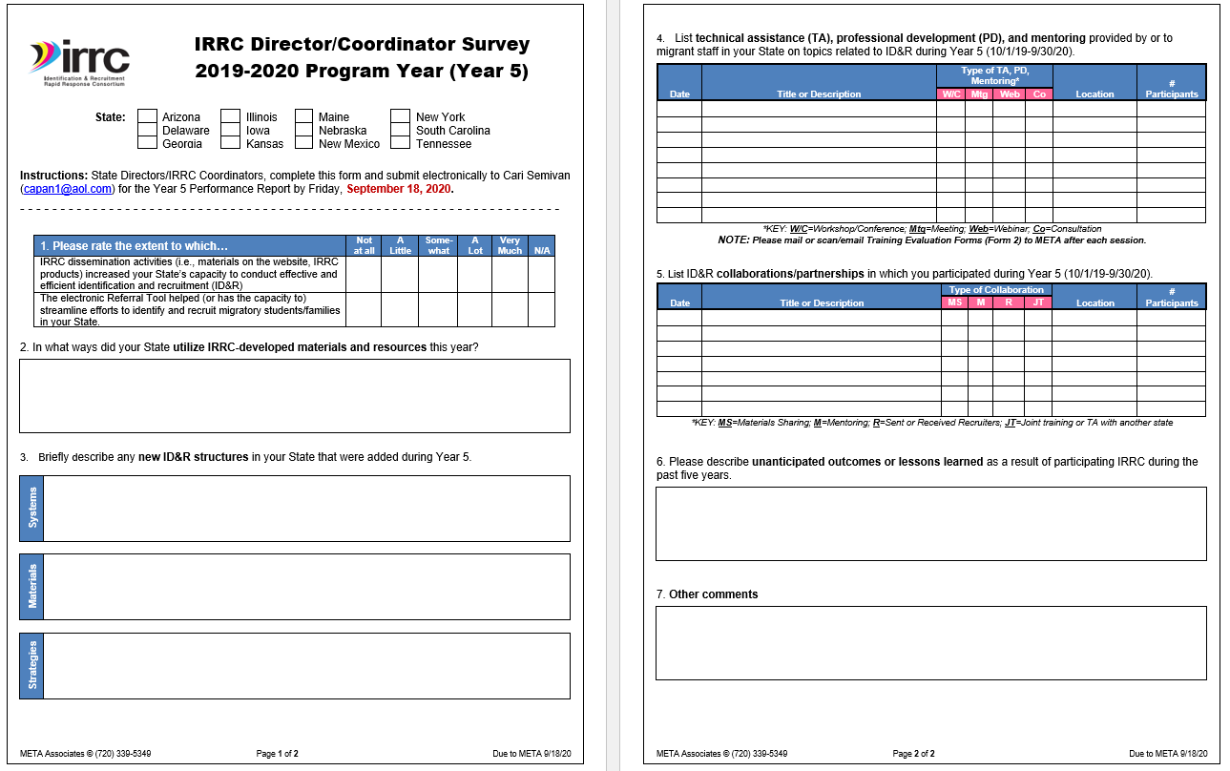
Form 1: IRRC Director/Coordinator Survey

Slide 7
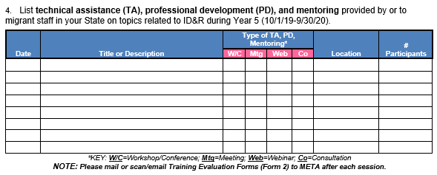
Provide Training in Your State
Submit Form 1 by 9/18/20
Provide technical assistance, PD, and mentoring to MEP staff in your state on topics related to ID&R
Document each training on Form 1: IRRC Director/Coordinator Survey (Item #4)

Slide 8
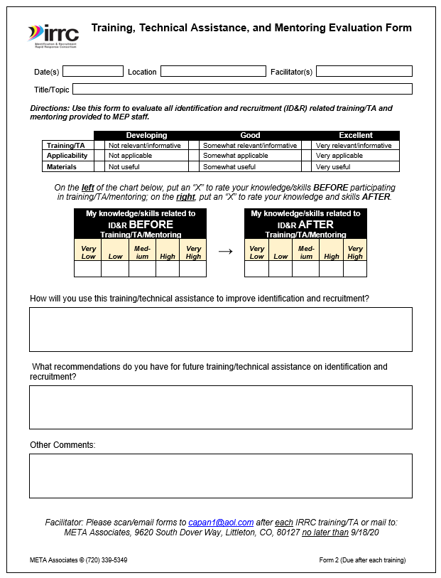
Evaluate Training/TA/ Mentoring
Evaluate each ID&R related training in your State using Form 2: Training, TA, and Mentoring Evaluation Form
Email to Cari upon completion of each training or by 9/18/20

Slide 9
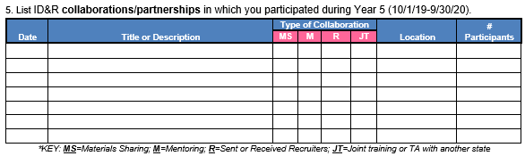
Collaborate
Submit Form 1 by 9/18/20
Collaborate with IRRC/other CIG states through resource sharing, mentoring, sending recruiters to assist/provide TA, and provide joint training
Document collaboration on Form 1: IRRC Director/Coordinator Survey (Item #5)

Slide 10


Form 3 IRRC PD Needs Assessment Survey
Online survey to determine areas of need for professional development related to eligibility, and recruitment strategies/ techniques.
Survey was closed on 1/13/20
117 MEP staff/recruiters from the IRRC States responded

Slide 11
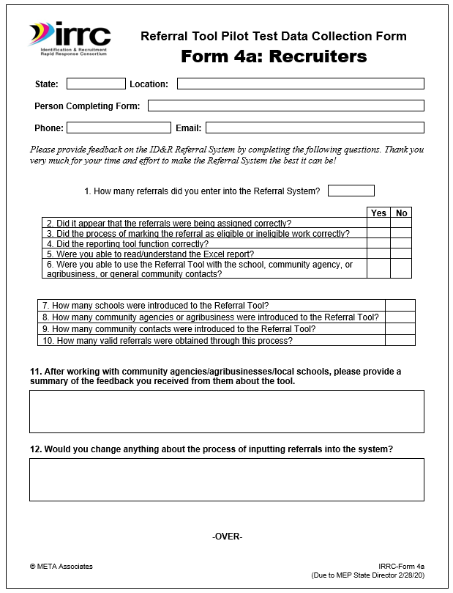
Form 4a: Recruiter Pilot Test Data Collection Form
2-page form that recruiters use to document the pilot test of the electronic Referral Tool.
Recruiters (3 per state) submit to State Directors by 2/28/20
State Directors submit to Cari by 3/6/20

Slide 12
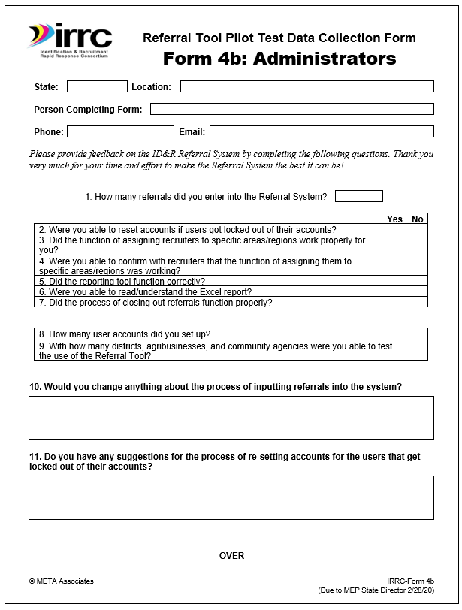
Form 4b: Administrator Pilot Test Data Collection Form
2-page form that administrators use to document the pilot test of the electronic Referral Tool.
Administrators (2 per state) submit to State Directors by 2/28/20
State Directors submit to Cari by 3/6/20

Slide 13
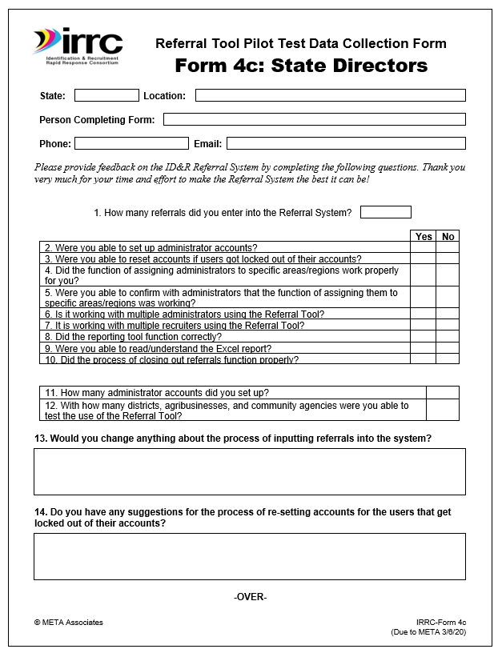
Form 4c: State Director Pilot Test Data Collection Form
2-page form that State Directors use to document the pilot test of the electronic Referral Tool.
State Directors submit to Cari by 3/6/20 (along with all other pilot test forms)

Slide 14



Slide 15



